Slide 1
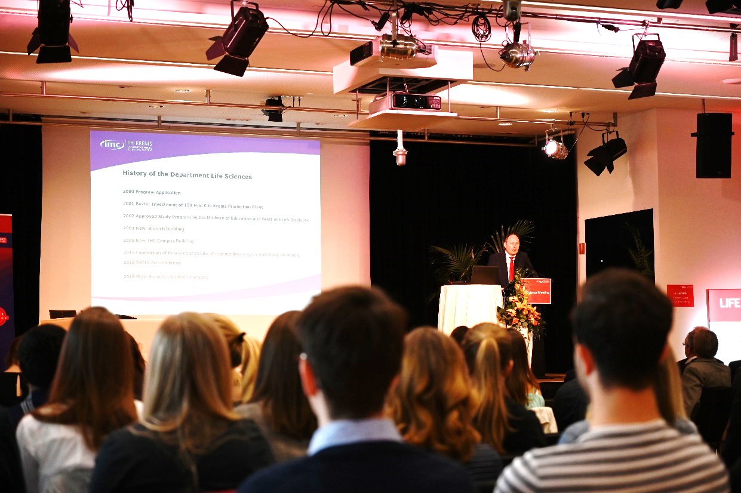
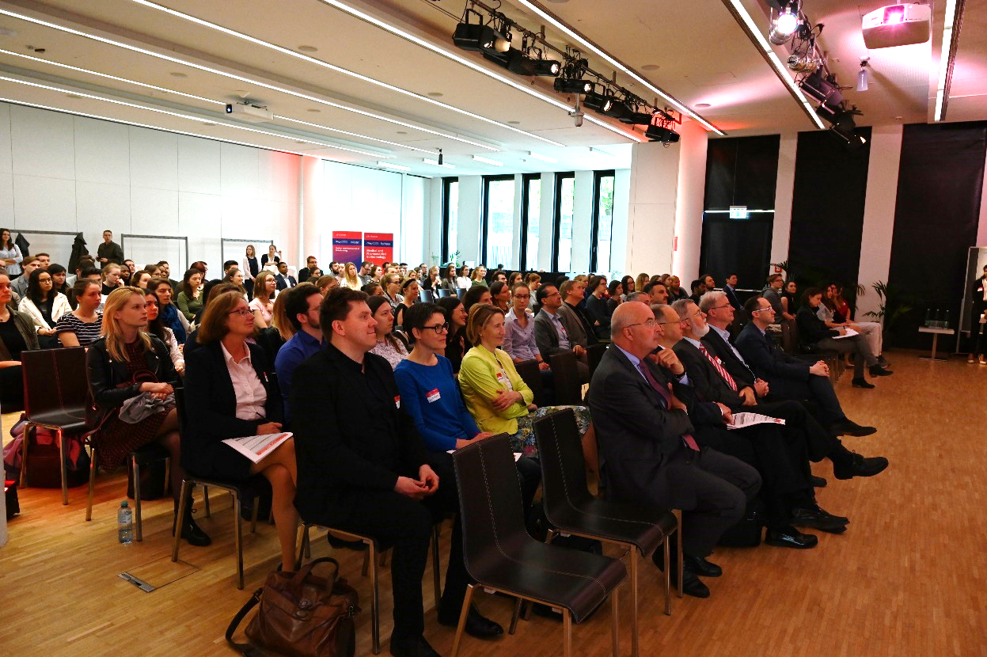
16th International Life Science Meeting
8. & 9. Mai 2019

Slide 2
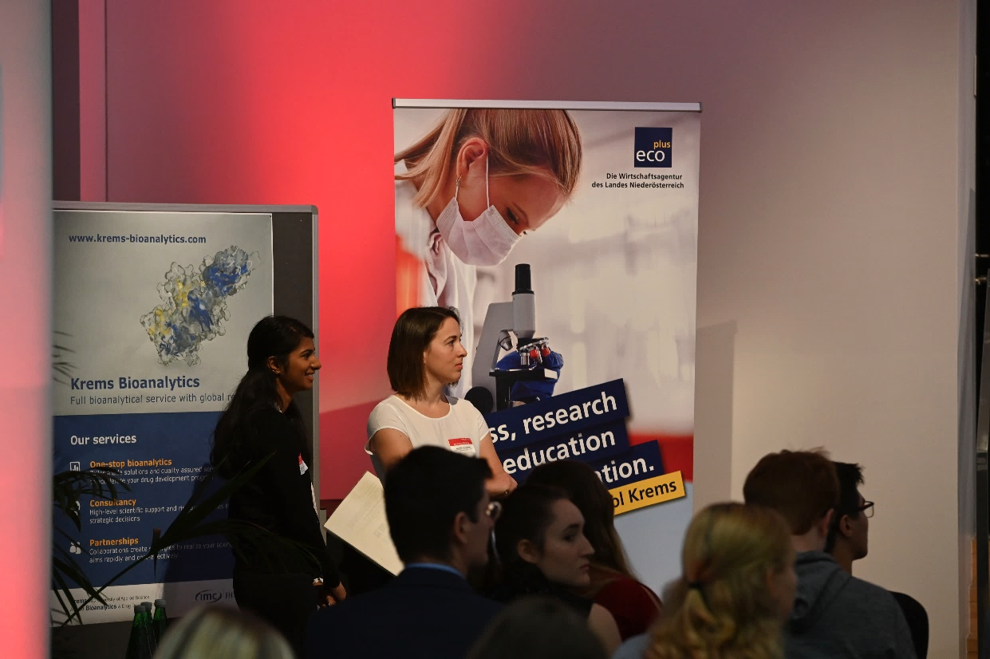
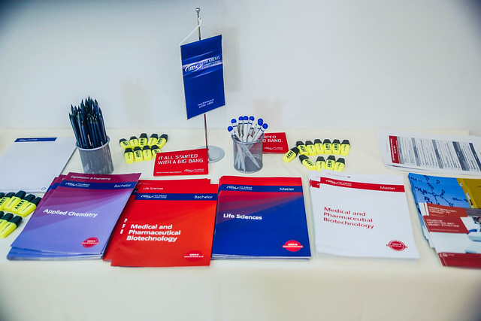
16th International Life Science Meeting
8. & 9. Mai 2019

